Slide 1
CS103 - Discrete Structures (Discrete Mathematics) Fall 2024
Lecture-1
Introduction Propositional Logic

Slide 2
Re-summarizing Course Objectives
Deep understanding of discrete structures used in Computer Science
Developing problem solving and analytical skills
Developing algorithmic and computational skills
Ability to understand mathematical arguments and their design
Understanding of logic
Proofing techniques

Slide 3
Topics in CS103
Formal Logic
Quantifiers and Predicates
Proof Techniques
Number Theory
Sequence and Summations
Induction and Recursion
Basic Set Theory
Relations
Functions
Graphs
Trees

Slide 4
Reasons to Study Discrete Structures
Proof
Ability to understand and create mathematical argument
Gateway to more advanced CS courses
Data structures, algorithms, automata theory, formal languages, Database, networks, operating system, security etc.

Slide 5
Logic
Logic is the study of the principles and methods that distinguishes between a valid and an invalid argument.
Logic deals with general reasoning laws, which you can trust.

Slide 6
Applications
Applied in proving program correctness and verification
Databases (Relational Algebra and calculus)
Artificial Intelligence

Slide 7
Propositional Logic
Proposition
A proposition is a declarative statement that is either TRUE or FALSE, but not both.
Example 1
2 + 2 = 4.
Lahore is the capital of Pakistan.
It is Sunday today.
Ali is student of this class.
Example 2
What time is it?
X + 1 = 2.
Close the door.
Read this carefully.

Slide 8
Propositional Logic
Letter are used to denote propositional variables, to symbolically represent propositions.
Letters used for this purpose are p, q, r, s,………
A propositional can have one of two values: true (T) or false (F).
Example
p = “Islamabad is the capital of Pakistan”
q = “17 is divisible by 3”

Slide 9
Propositional Logic
The area of logic that deals with propositions is called the Propositional Calculus or Propositional Logic.
Compound Propositions are constructed by combining one or more propositions using logical operators (connectives).
Examples
“3 + 2 = 5” and “Lahore is a city in Pakistan”
“The grass is green” or “ It is hot today”

Slide 10
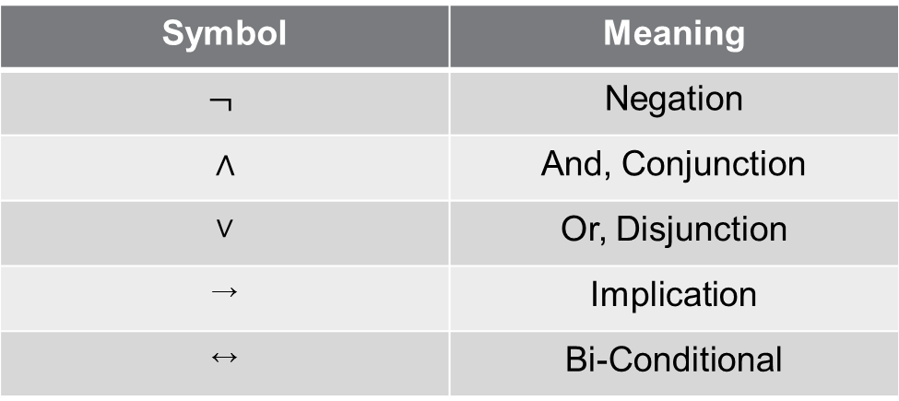
Symbols for Logical Operators
Symbol | Meaning
$$¬$$ | Negation
$$∧$$ | And, Conjunction
$$∨$$ | Or, Disjunction
→ | Implication
↔ | Bi-Conditional

Slide 11
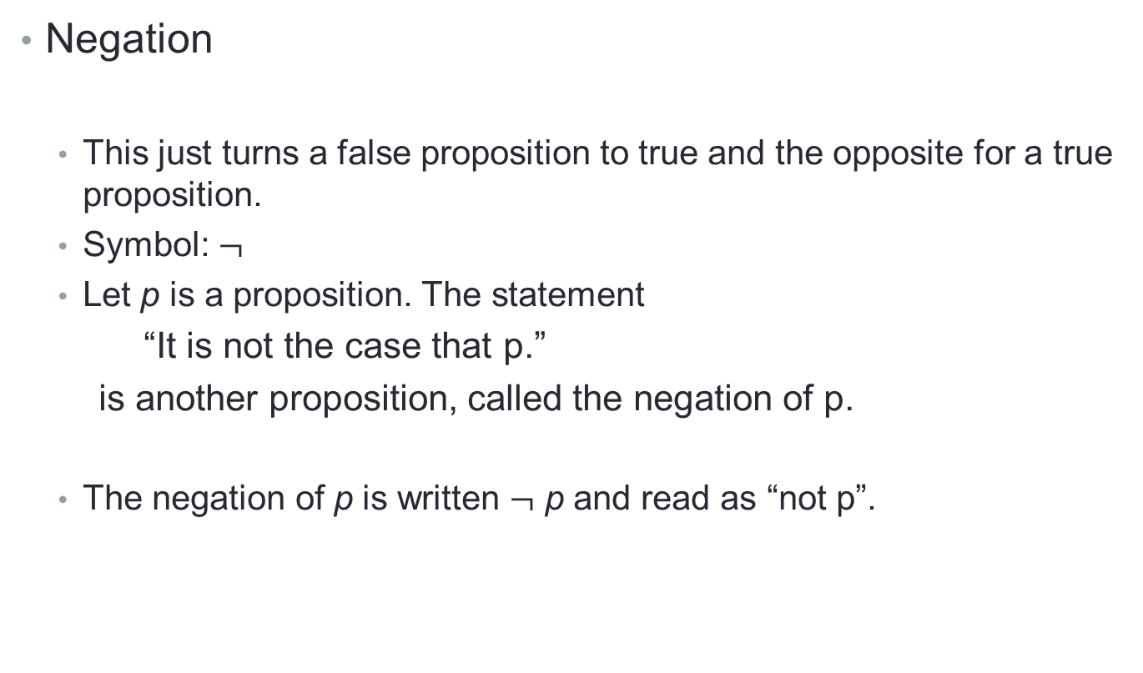
Logical Operators (Logical connectives)
Negation
This just turns a false proposition to true and the opposite for a true proposition.
Symbol: $¬$
Let p is a proposition. The statement
“It is not the case that p.”
is another proposition, called the negation of p.
The negation of p is written $¬$p and read as “not p”.

Slide 12
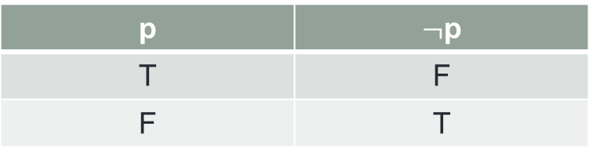

Logical Operator - Negation
Logical operators are defined by truth tables –tables which give the output of the operator in the right-most column.
Here is the truth table for negation:
p | $¬$p
T | F
F | T
P
$¬$P

Slide 13
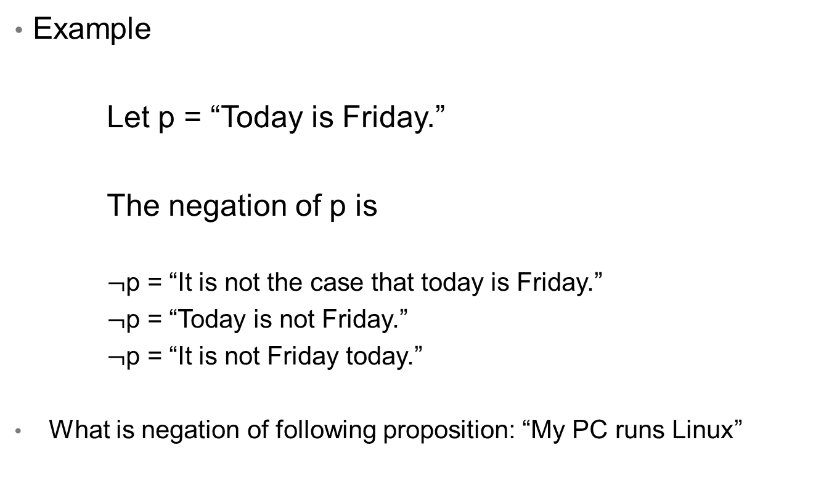
Logical Operator - Negation
Example
Let p = “Today is Friday.”
The negation of p is
$¬$p = “It is not the case that today is Friday.”
$¬$p = “Today is not Friday.”
$¬$p = “It is not Friday today.”
What is negation of following proposition: “My PC runs Linux”

Slide 14
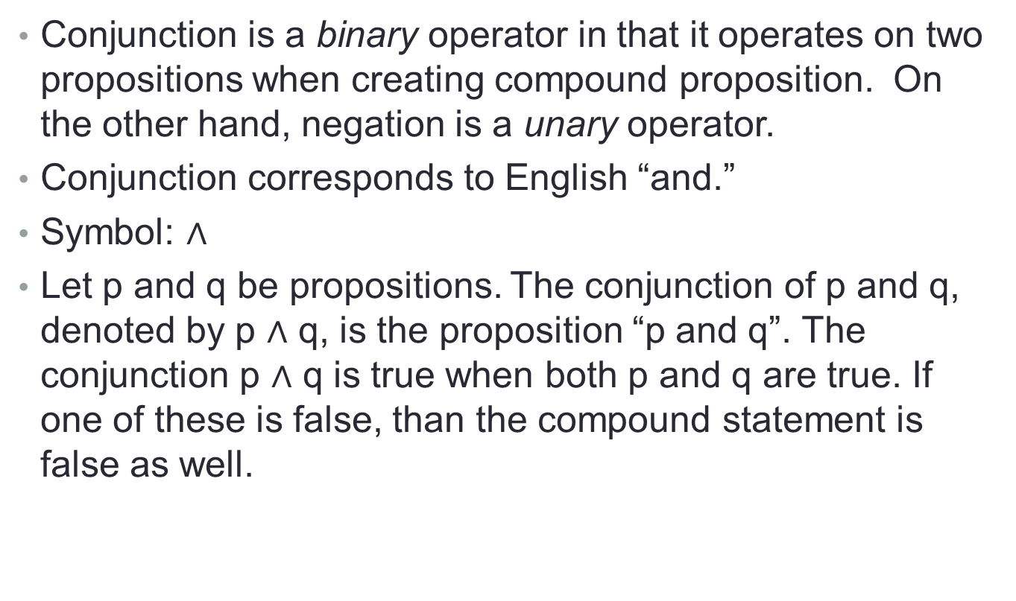
Logical Operator - Conjunction
Conjunction is a binary operator in that it operates on two propositions when creating compound proposition. On the other hand, negation is a unary operator.
Conjunction corresponds to English “and.”
Symbol: $∧$
Let p and q be propositions. The conjunction of p and q, denoted by p $∧$q, is the proposition “p and q”. The conjunction p $∧$qis true when both p and q are true. If one of these is false, than the compound statement is false as well.

Slide 15
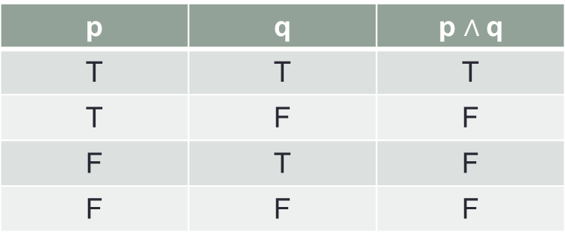
Logical Operator - Conjunction
Truth Table
p | q | p$∧$q
T | T | T
T | F | F
F | T | F
F | F | F

Slide 16

Logical Operator - Conjunction
Example
Let p = “Today is Friday.”
and q = “It is raining today.”
p $∧$q = “Today is Friday and it is raining today.”

Slide 17
Logical Operator - Conjunction
Hamza’s PC has more than 16 GB free hard disk space, and the processor in Hamza’s PC runs faster than 1 GHz.
It is cold but sunny.

Slide 18
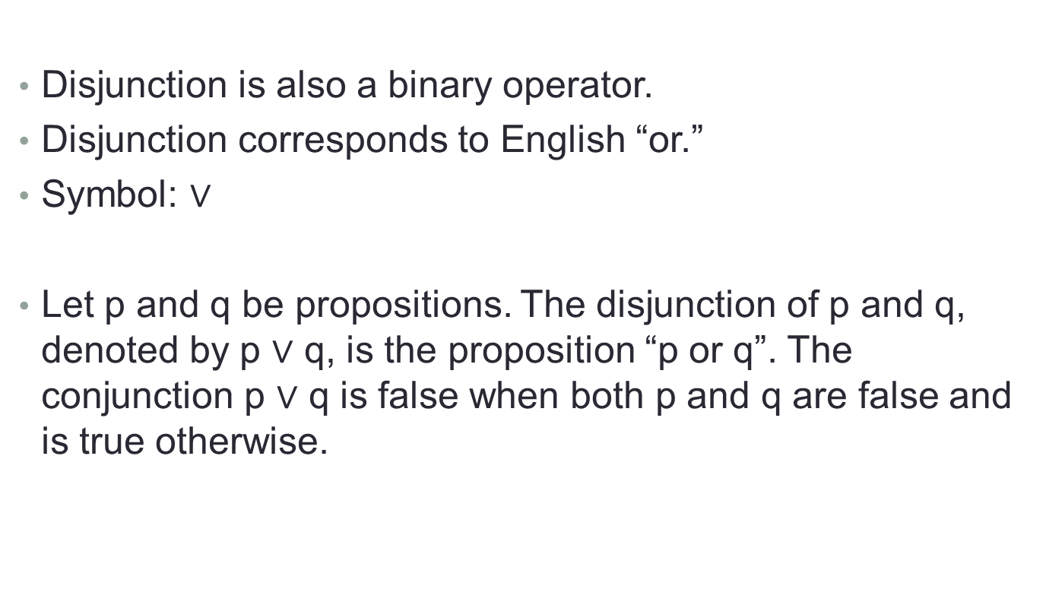
Logical Operator - Disjunction
Disjunction is also a binary operator.
Disjunction corresponds to English “or.”
Symbol:$∨$
Let p and q be propositions. The disjunction of p and q, denoted by p$∨$q, is the proposition “p or q”. The conjunction p$∨$q is false when both p and q are false and is true otherwise.

Slide 19
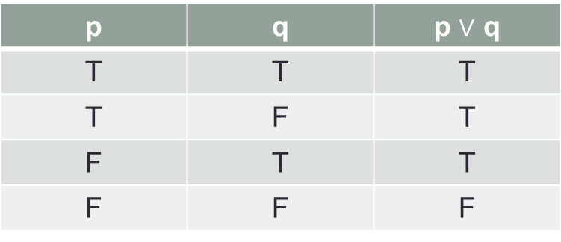
Logical Operator - Disjunction
Truth Table
p | q | p $∨$ q
T | T | T
T | F | T
F | T | T
F | F | F

Slide 20

Logical Operator - Disjunction
Example
Let p = “Today is Friday.”
and q = “It is raining today.”
p$∨$q = “Today is Friday or it is raining today.”

Slide 21

Example
Let p = “it is hot”,
q = “it is sunny”
It is hot and sunny p $∧$ q
It is not hot but sunny $¬$p $∧$ q
It is neither hot nor sunny $¬$p $∧¬$q

Slide 22
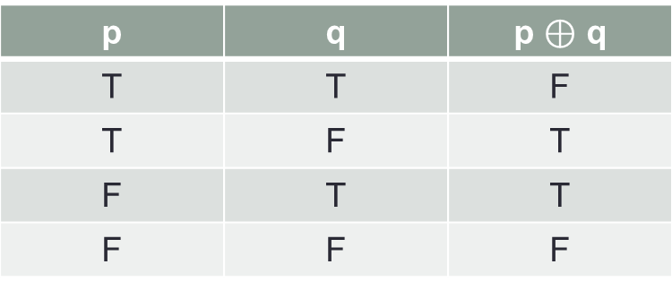

Logical Operator – Exclusive Or
Symbol: $⊕$
Let p and q be propositions. The exclusive or of p and q, denoted by p $⊕$ q , is the proposition that is true when exactly one of p and q is true and is false, and false otherwise.
Truth Table
p | q | p$⊕$ q
T | T | F
T | F | T
F | T | T
F | F | F

Slide 23
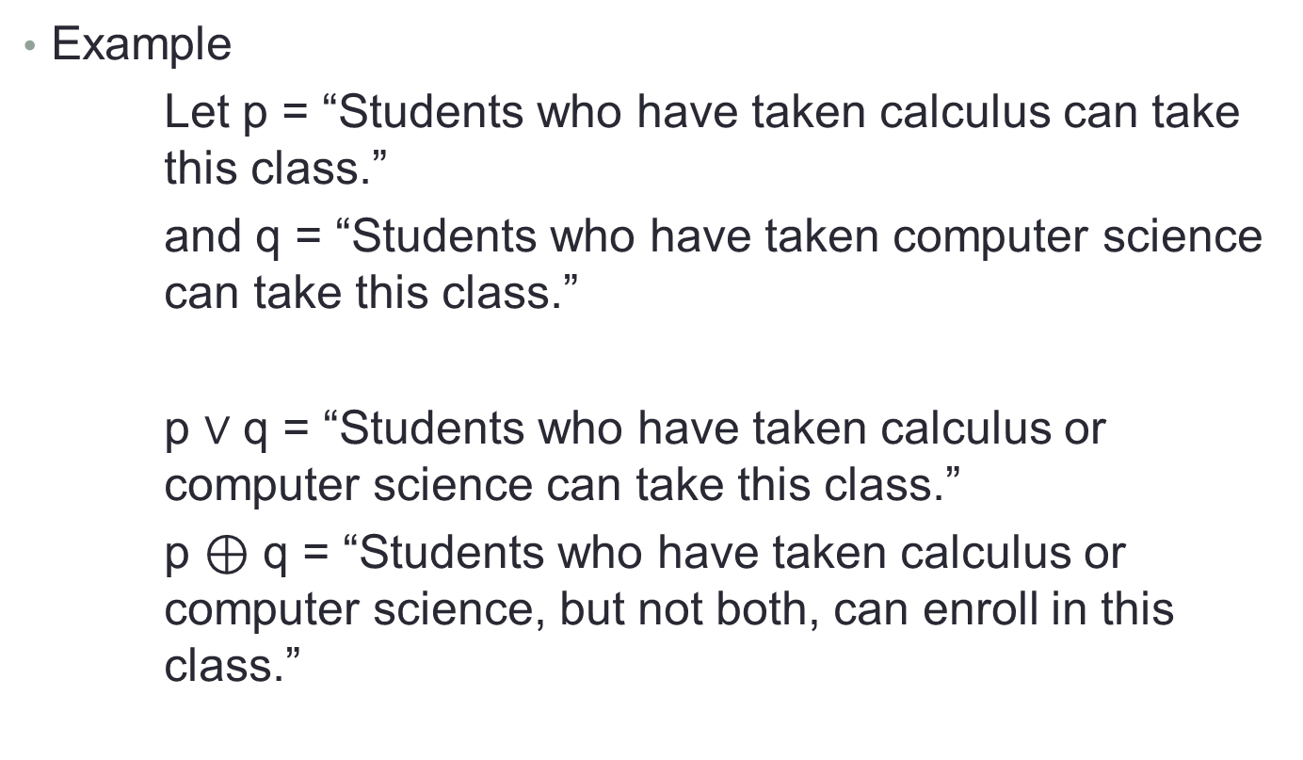
Logical Operator – Exclusive Or
Example
Let p = “Students who have taken calculus can take this class.”
and q = “Students who have taken computer science can take this class.”
p $∨$ q = “Students who have taken calculus or computer science can take this class.”
p $⊕$ q = “Students who have taken calculus or computer science, but not both, can enroll in this class.”

Slide 24
Exclusive or Versus Inclusive or (Disjunction)
Coffee or tea comes with dinner.
A password must have at least three digits or be at least five characters long.
Lunch includes soup or salad.
Experience with C++ or Java is required.
Exclusive or
Inclusive or
Exclusive or
Inclusive or

Slide 25
Logical Operator – Implication
p → q corresponds to English “if p then q,” or “p implies q.”
Symbol: →
The implication p → q is the proposition that is false when p is true and q is false, and true otherwise.
Examples
If it is raining then it is cloudy.
If you get 100% on the final, then you will get an A.
If p then 2+2 = 4.
p → q
Hypothesis
Conclusion

Slide 26
Logical Operator – Implication
Truth Table
p | q | p → q
T | T | T
T | F | F
F | T | T
F | F | T

Slide 27
Logical Operator – Implication
Alternate ways of stating an implication
p implies q
If p, q
p only if q
p is sufficient for q
q if p
q whenever p
q is necessary for p

Slide 28
Implication - Example
p: you get 100% on the final
q: you will get an A
p implies that q.
you get 100% on the final implies that you will get an A.
If p, then q.
If you get 100% on the final, then that you will get an A.
If p, q.
If you get 100% on the final, that you will get an A.
p is sufficient for q.
Get 100% on the final is sufficient for getting an A.
q if p.
you will get an A if you get 100% on the final.
q unless ￢ p.
you will get an A unless you don’t get 100% on final.

Slide 29
Logical Operator – Implication
Converse
The proposition q → p is converse of p → q.
Contrapositive
The contrapositive of p → q is the proposition ￢q →￢p.
Inverse
The proposition ￢p →￢q is called the inverse of p → q.

Slide 30
Logical Operator – Implication
Example
“The home team wins whenever it is raining?”
Because “q whenever p”, so p → q, the original statement can be rewritten as “If it is raining, then the home team wins.”
Contrapositive
“If the home team does not win, then it is not raining.”
Converse
“If the home team wins, then it is raining.”
Inverse
“If it is not raining, then the home team does not win.”

Slide 31
Logical Operator – Bi-conditional
p ↔ q corresponds to English “p if and only if q.”
Symbol: ↔
The bi-conditional statement p ↔ q is true when p and q have the same truth values, and is false otherwise.
Bi-conditional statements are also called bi-implications.
Alternatively, it means “(if p then q) and (if q then p)”
Example
“You can take the flight if and only if you buy a ticket.”

Slide 32
Logical Operator – Bi-conditional
Truth Table
p | q | p ↔ q
T | T | T
T | F | F
F | T | F
F | F | T

Slide 33
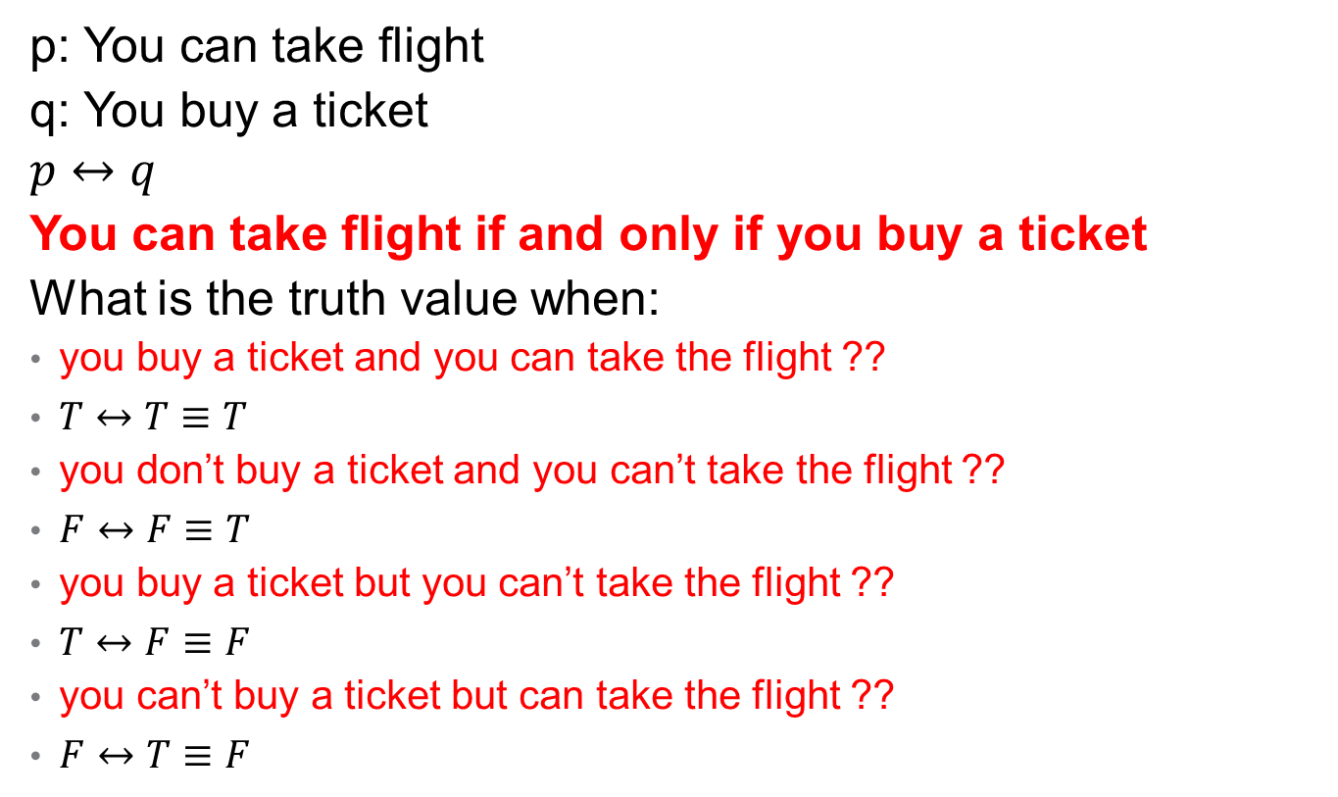
Logical Operator – Bi-conditional
p: You can take flight
q: You buy a ticket
$$p↔q$$
You can take flight if and only if you buy a ticket
What is the truth value when:
you buy a ticket and you can take the flight ??
$T↔T≡T$
you don’t buy a ticket and you can’t take the flight ??
$F↔F≡T$
you buy a ticket but you can’t take the flight ??
$T↔F≡F$
you can’t buy a ticket but can take the flight ??
$F↔T≡F$

Slide 34
Logical Operator – Bi-conditional
Other English equivalents:
“p if and only if q”
“p is equivalent to q”
“p is necessary and sufficient for q”
“p iff q”
“If p then q, and conversely”

Slide 35
Bi-conditional -Example
p: “You can take the flight”
q: “You buy a ticket”
p ↔ q:
You can take the flight if and only if you buy a ticket
You can take the flight iff you buy a ticket
The fact that you can take the flight is necessary and sufficient for buying a ticket

Slide 36
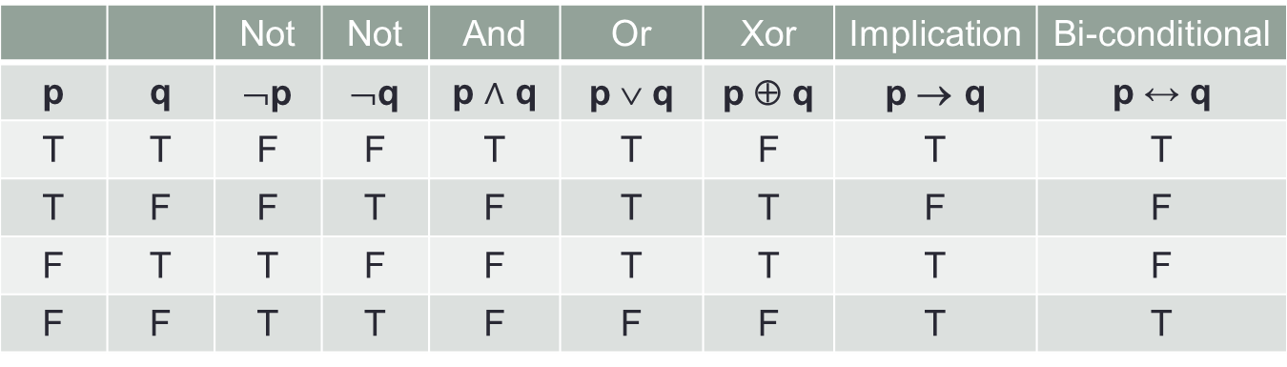
Logical Operators Summary
 |  | Not | Not | And | Or | Xor | Implication | Bi-conditional
p | q | ¬p | ¬q | p$∧$ q | p ∨ q | p ⊕ q | p → q | p ↔q
T | T | F | F | T | T | F | T | T
T | F | F | T | F | T | T | F | F
F | T | T | F | F | T | T | T | F
F | F | T | T | F | F | F | T | T

Slide 37
Truth Table of Compound Propositions
Construction of a truth table:
Rows
Need a row for every possible combination of values for the every propositions.
Columns
Need a column for the truth value of each expression that occurs in the compound proposition as it is built up.
Need a column for the compound proposition (usually at far right)
This includes the atomic propositions

Slide 38
Truth Table of Compound Propositions
(p ∨￢q) → (p ∧ q)
p | q | ￢q | p ∨￢q | p ∧ q | (p ∨￢q) → (p ∧ q)
T | T | F | T | T | T
T | F | T | T | F | F
F | T | F | F | F | T
F | F | T | T | F | F

Slide 39
Truth Table of Compound Propositions
p → (￢q ∧ r )
p | q | r | ￢q | ￢q ∧ r | p → (￢q ∧ r )
T | T | T | F | F | F
T | T | F | F | F | F
T | F | T | T | T | T
T | F | F | T | F | F
F | T | T | F | F | T
F | T | F | F | F | T
F | F | T | T | T | T
F | F | F | T | F | T

Slide 40
Precedence of Logical Operators
Just as in algebra, operators have precedence
4+3*2 = 4+(3*2), not (4+3)*2
Example
This means that
p ∨ q ∧ ¬r → s ↔ t yields: (p ∨ (q ∧ (¬r)) → s) ↔ (t)
Operator | Precedence
¬ | 1
∧ | 2
∨ | 3
→ | 4
↔ | 5

Slide 41
Truth Tables
Construct the truth table of following compound propositions
p →￢p
p ⊕ p
(q →￢p) ↔ (p ↔ q)

Slide 42
Chapter Reading
Chapter 1, Kenneth H. Rosen, Discrete Mathematics and Its Applications

Slide 43
Chapter Exercise ( For Practice)
Question # 1, 2, 3, 4, 8, 9, 13, 24, 27, 28, 31, 32

